Slide 1
Sever document
Andy, Yu-Guang Chen
Assistant Professor, Department of EE
National Central University
andyygchen@ee.ncu.edu.tw
Slides Credit: TA金昌明

Slide 2
Outline
Workstation
Vim
Tmux

Slide 3
Outline
Workstation
Vim
Tmux

Slide 4
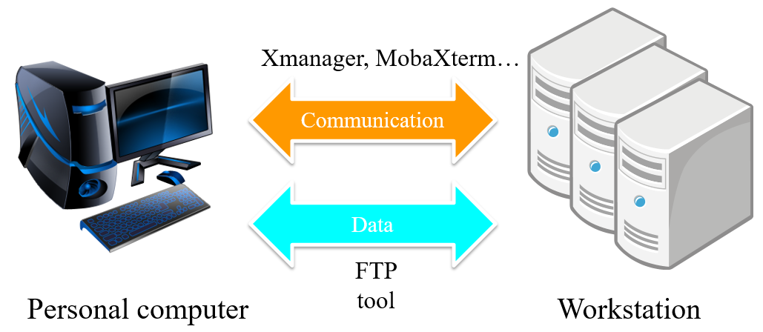
Workstation
Introduction of workstation

Slide 5
Workstation
Basic information
System: CentOS 6.10
Host: 140.115.71.233
Port: 22 ( Please use SSH to connect to the machine )
Default account/password: Account: “s” + Your Student_ID Password: EE6094

Slide 6
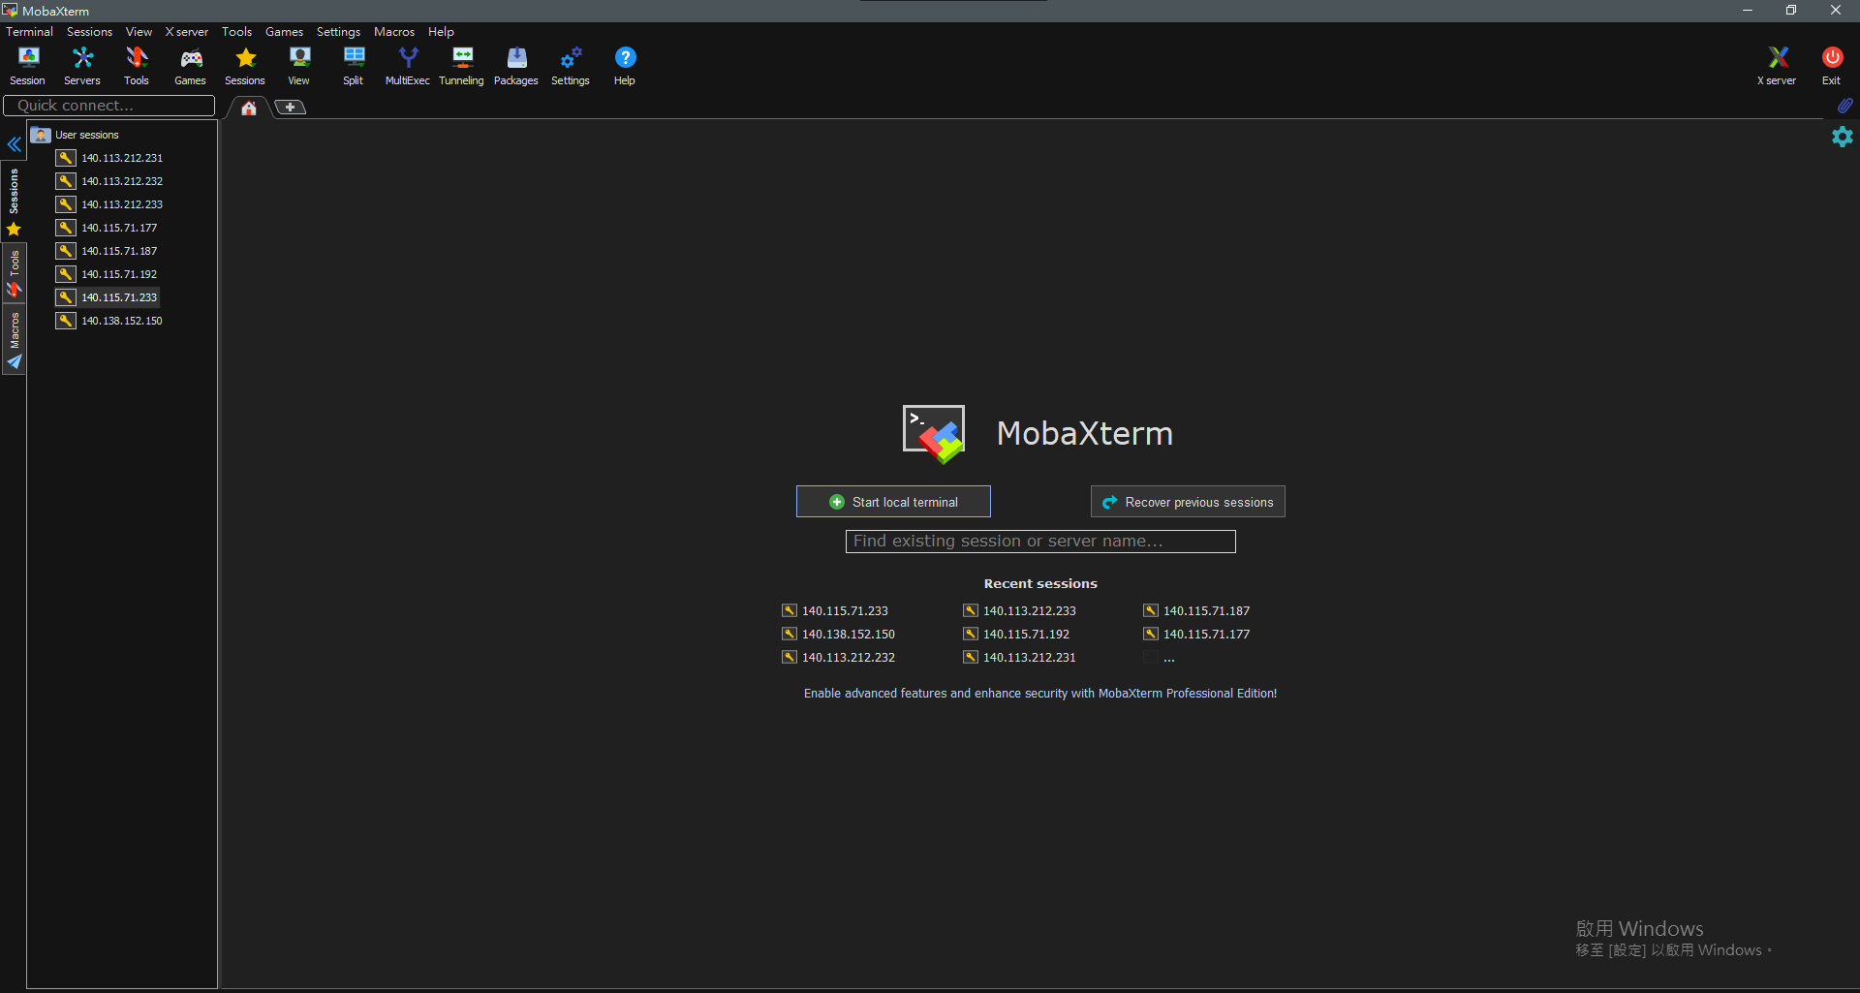
Workstation
How to connect linux server
MobaXterm

Slide 7
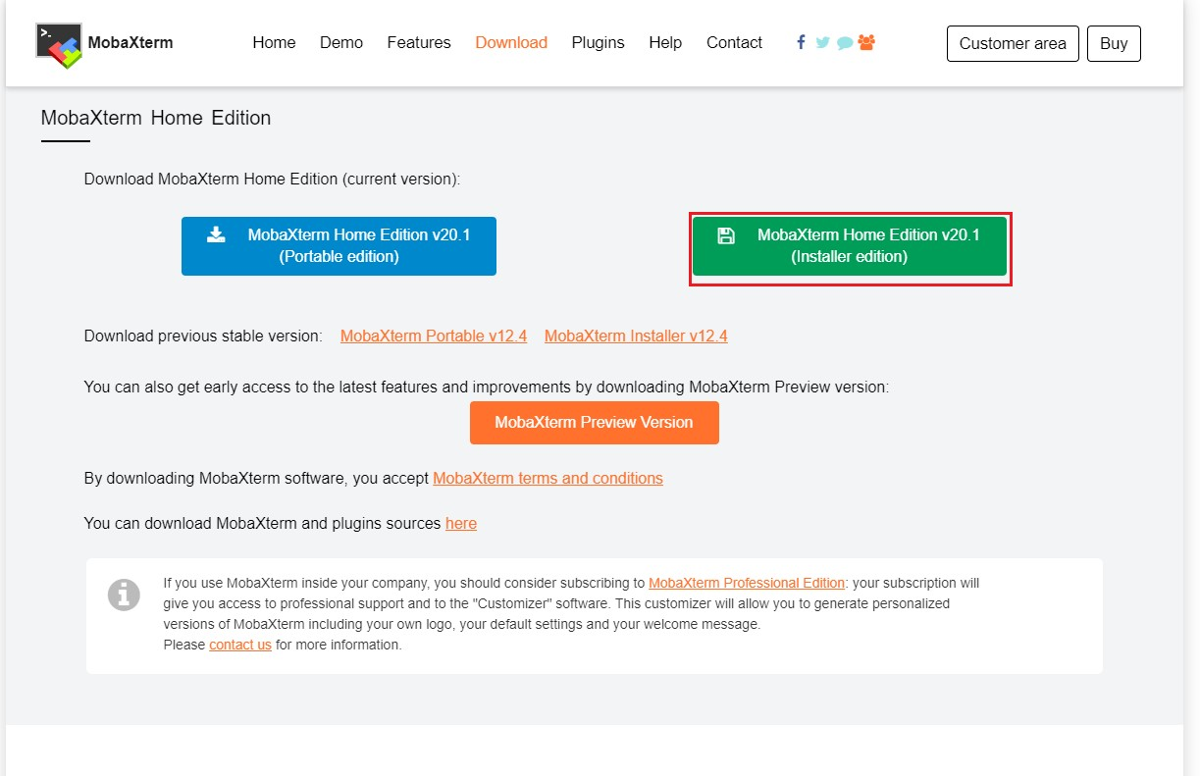
Workstation
How to connect linux server
Step 1: download MobaXterm https://mobaxterm.mobatek.net/download-home-edition.html

Slide 8
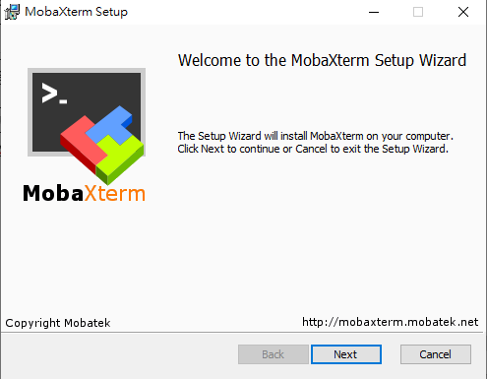
Workstation
How to connect linux server
Step 2-1: install MobaXterm

Slide 9
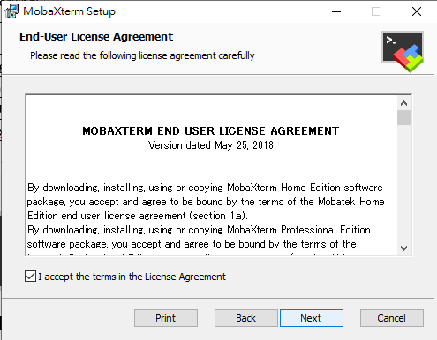
Workstation
How to connect linux server
Step 2-2: install MobaXterm

Slide 10
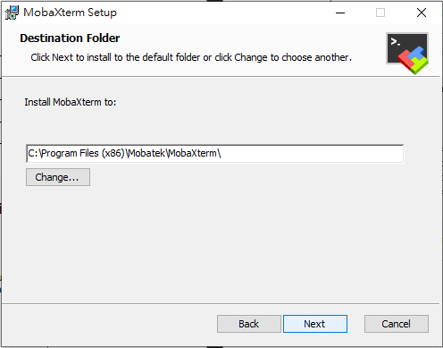
Workstation
How to connect linux server
Step 2-3: install MobaXterm

Slide 11
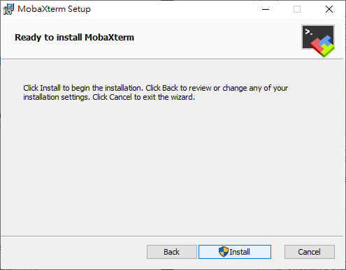
Workstation
How to connect linux server
Step 2-4: install MobaXterm

Slide 12
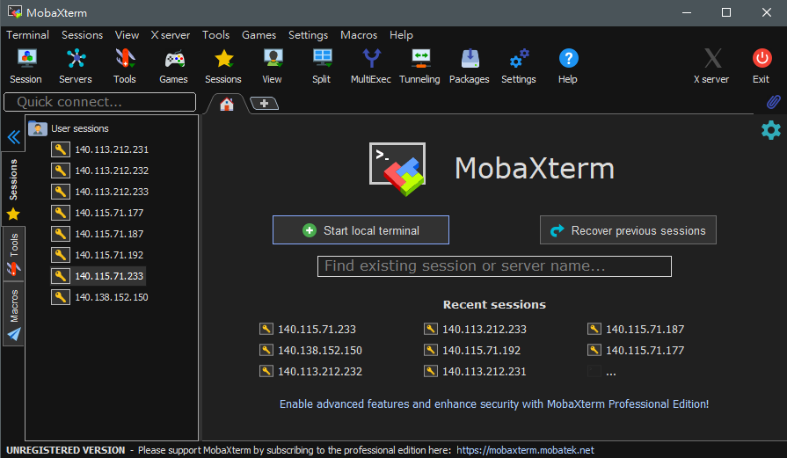
Workstation
How to connect linux server
Step 3-1: Click session to create a new session

Slide 13
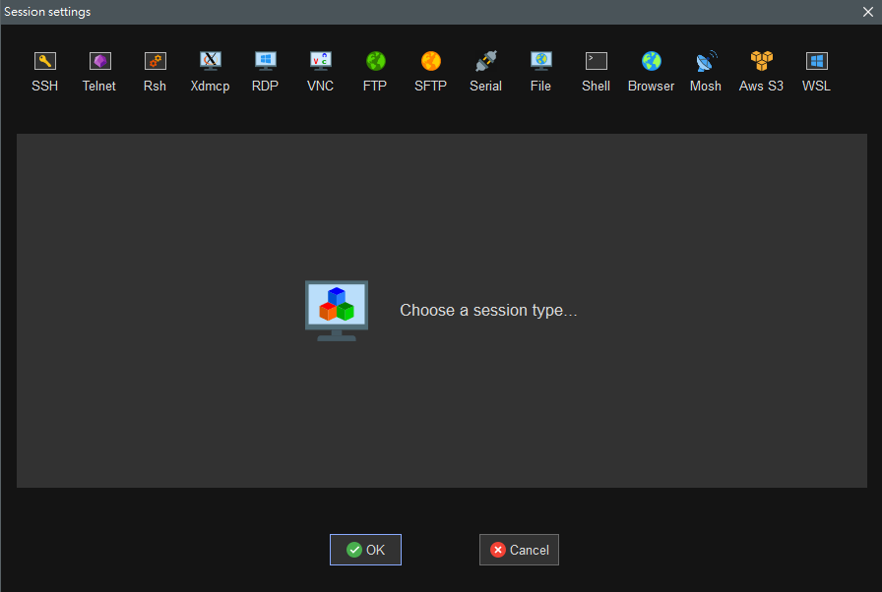
Workstation
How to connect linux server
Step 3-2: Click ssh to create a new SSH session

Slide 14
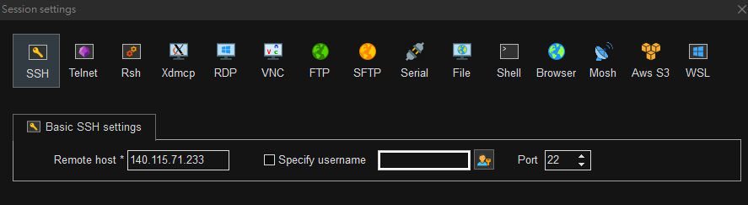
Workstation
How to connect linux server
Step 3-3: Fill in the given Host to the Host field and set the port number to 22

Slide 15
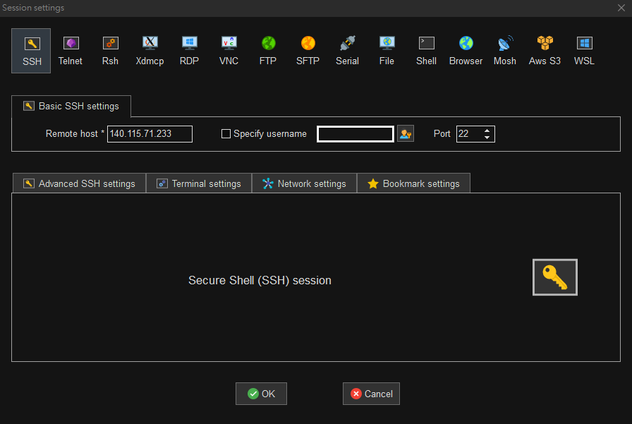
Workstation
How to connect linux server
Step 3-4: Click ok

Slide 16
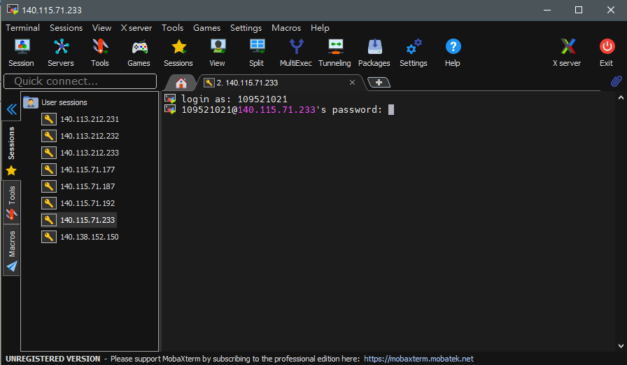
Workstation
How to connect linux server
Step 3-5: Login

Slide 17
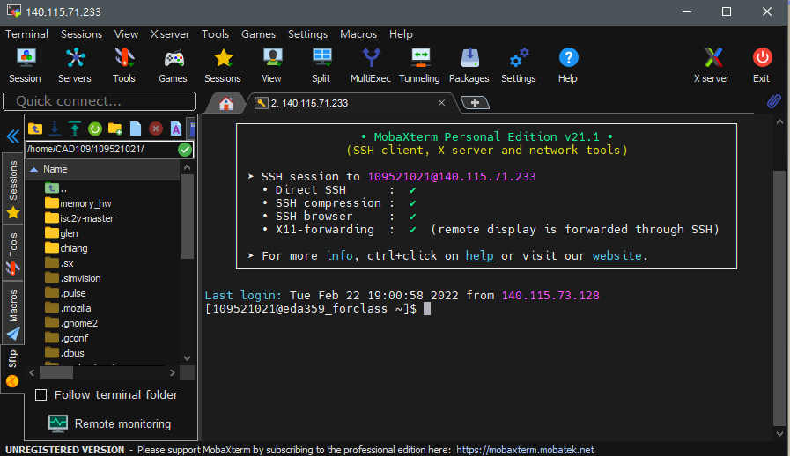
Workstation
How to connect linux server
Step 3-6: Login

Slide 18
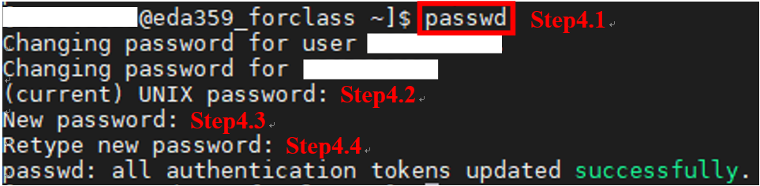
Workstation
Change your workstation password
Step 4-1: Key in “ passwd ”
Step 4-2: Key in your current password
Step 4-3: Key in your new password
Step 4-4: Retype your new password again:w

Slide 19
Basic command of workstation
ls (list)
ll (long list format)
cd (change directory)
pwd (print working directory)
cp (copy)
mv (move)
rm (remove)
mkdir (make directory)
rmdir (remove directory)
tar (compression tool)
passwd (password)
Ctrl + c (force quit)
ps (process status)
kill (kill process)

Slide 20



Basic Command
mkdir
ls
cd

Slide 21
Basic Command
mkdir
ls
cd

Slide 22

Basic Command
cp
rm

Slide 23
Basic Command
cp
rm

Slide 24
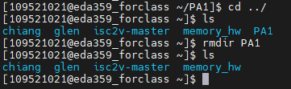
Basic Command
rmdir

Slide 25
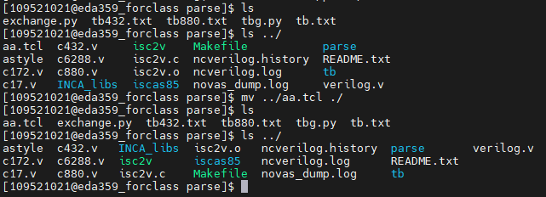
Basic Command
mv

Slide 26
Basic Command
mv

Slide 27
Basic Command
mv

Slide 28
Basic Command
mv

Slide 29
Basic Command
mv

Slide 30
Basic Command
mv

Slide 31
Outline
Workstation
Vim
Tmux

Slide 32

Vim
It is an efficient text editor especially developed for Linux users. This editor is mainly used to edit or create different types of files.
Open parser.cpp or create a new file which named parser.cpp.

Slide 33

Vim
Normal mode
You will see the below screen after executing the command. This is your normal mode in Vim.

Slide 34
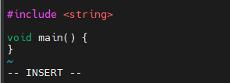
Vim
Insert mode
You should be in the Insert mode if you want to edit your file.
Press “i”, “a” or “o” from your keyboard, and you will be in insert mode.
Press Esc to back to normal mode.

Slide 35
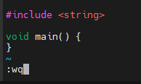
Vim
Saving your work
When you are in normal mode, press “:w” to save your work and press “:q” to exit vim.
You also can use “:wq” to save and exit vim.

Slide 36
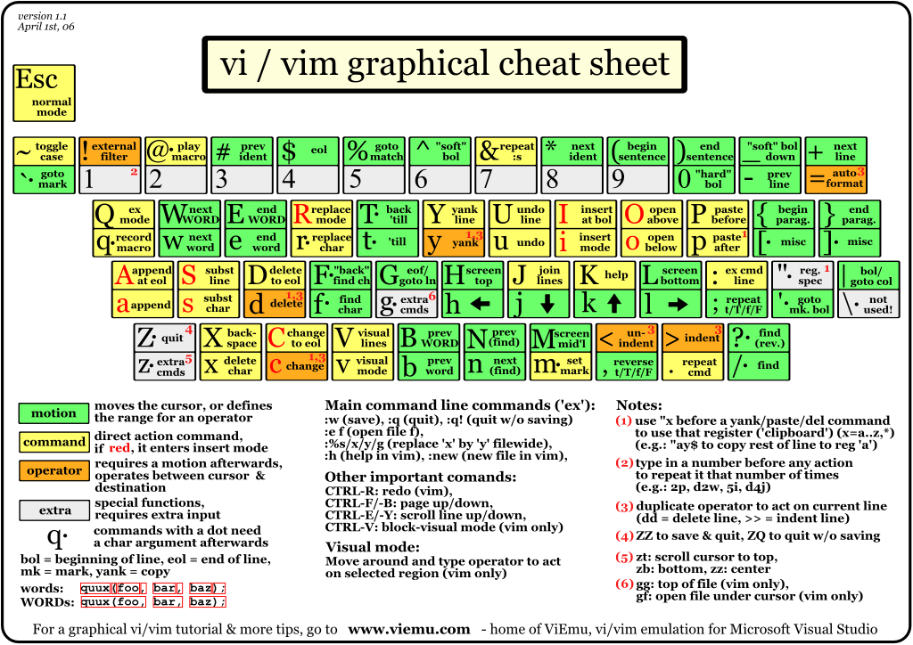
Vim

Slide 37
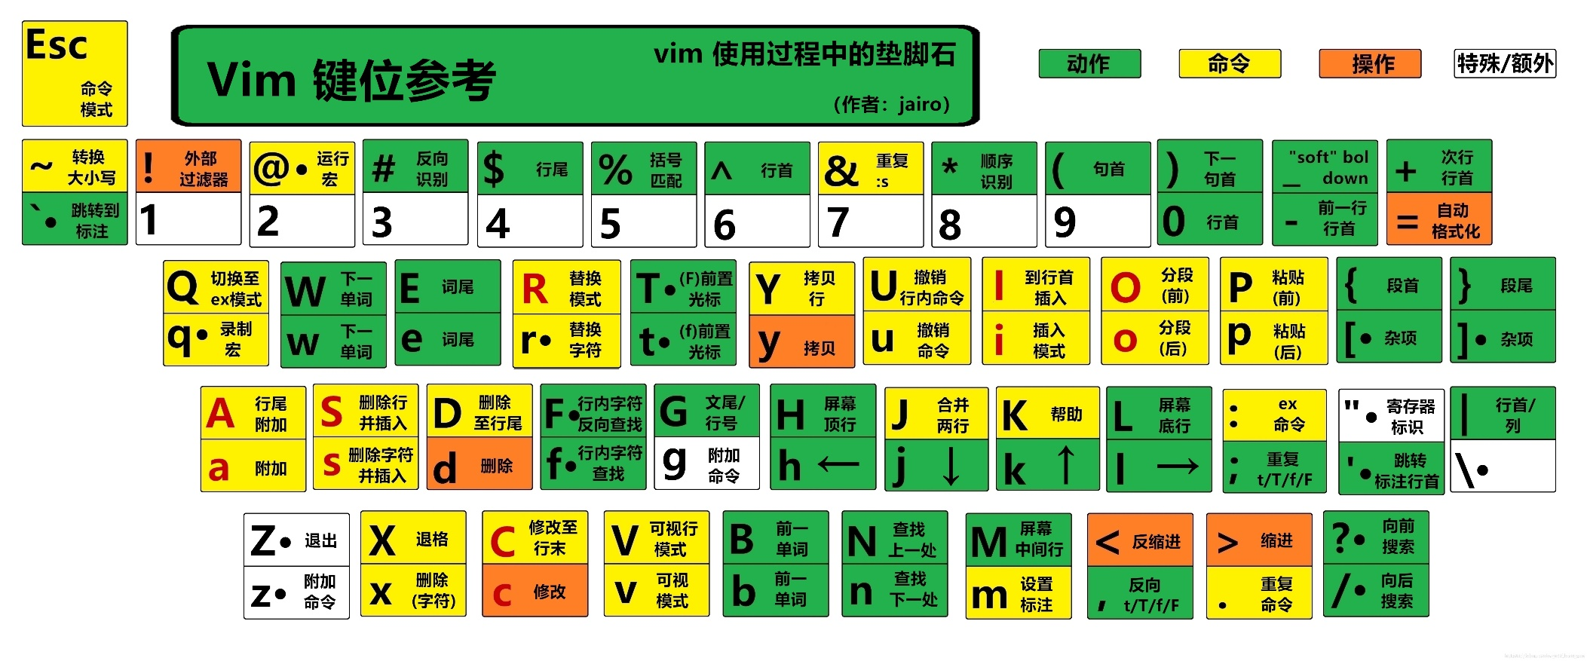
Vim

Slide 38
Outline
Workstation
Vim
Tmux

Slide 39

Tmux
What is tmux?
Tmux is a terminal multiplexer that you can start a Tmux session and then open multiple windows inside that session.

Slide 40
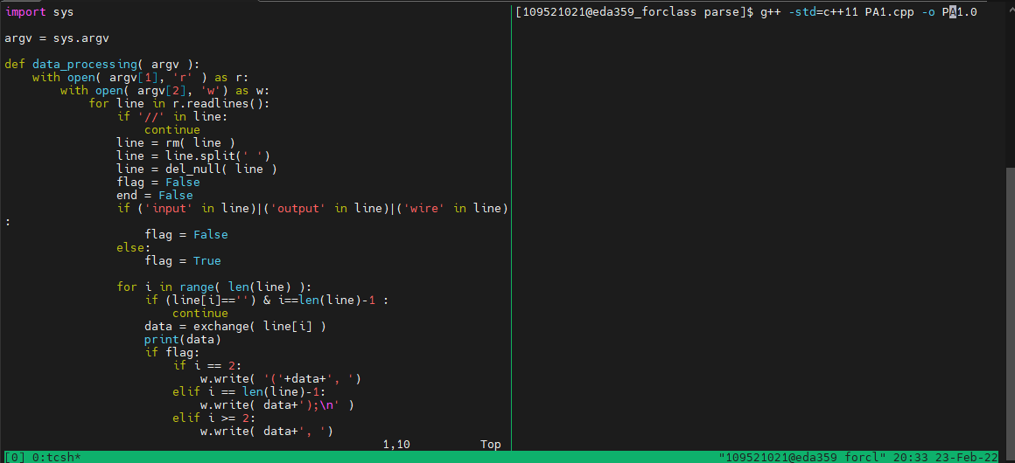
Tmux

Slide 41
Tmux
Working with tmux windows and panes
Ctrl+b c: Create a new window.
Ctrl+b w: Choose window from a list.
Ctrl+b 0: Switch to window 0.
Ctrl+b n: Switch to next window.
Ctrl+b p: Switch to previous window.
Ctrl+b %: Split current pane horizontally into two panes.
Ctrl+b “: Split current pane vertically into two panes.
Ctrl+b arrow keys: Switch pane.

Slide 42
Reference
Linux
https://files.fosswire.com/2007/08/fwunixref.pdf
Vim
http://www.vixual.net/blog/archives/234
Tmux
https://blog.gtwang.org/linux/linux-tmux-terminal-multiplexer-tutorial/

